Slide 1
Costs

Slide 2
OPPORTUNITY COST
A firm’s total cost of producing a given level of output is the opportunity cost of the owners
    Everything they must give up in order to produce that amount of output
Opportunity cost is the most fundamental cost concept.
  The opportunity cost of doing or getting something is:
what you could have done or gotten instead
Example: Your opportunity cost for taking this class includes:
Whatever else you could have bought with your tuition and fee money
  plus
the work, family participation, and recreation that you are not doing because you are here.

Slide 3
ACCOUNTING & ECONOMIC COSTS
Accounting cost is the concept that goods or services cost what was paid for them.
Economic cost is the amount required to keep a resource in its present use; the amount that it would be worth in its next best alternative use.
Economists & Accountants calculate costs differently:
  Economists are interested in studying how firms make production & pricing decisions. They include all costs.
  Accountants are responsible for keeping track of the money that flows into and out of firms. They focus on explicit costs.
  Economic Costs = Explicit + Implicit Costs
  Accounting Costs = Explicit Costs

Slide 4
Implicit and Explicit Costs
Explicit Costs: Costs that involve an exchange of money
  Explicit (involving actual payments)
    Money actually paid out for the use of inputs
-ie: Rent, Wages, Licence, Materials
Implicit Costs: Costs that don’t involve an exchange of money
  Implicit (no money changes hands)
    The cost of inputs for which there is no direct money payment
-ie: Wage that could have been earned working elsewhere

Slide 5
Costs Example
Last year, John decided to open a box factory. Hugo built the factory for $200,000. Materials and wages required to make a box amount to 5 cents per box.
Before starting production, John was offered a job at BoxMart that paid $4,000 a month.
Classify John’s costs (explicit, implicit, economic, accounting, and sunk)

Slide 6
Explicit Costs:
Factory ($200K)
Production (5 cents/box + ongoing cost)
Implicit Costs:
Forgone Wage ($4,000/month)
Accounting Costs=Explicit Costs
Economic Costs = Explicit+Implicit Costs
Sunk Costs= Factory ($200K)

Slide 7
Fixed costs
  Costs of a firm’s fixed inputs
Variable costs
  Costs of obtaining the firm’s variable inputs

Slide 8
Types of total costs
  Total fixed costs
    Cost of all inputs that are fixed in the short run
  Total variable costs
    Cost of all variable inputs used in producing a particular level of output
  Total cost
    Cost of all inputs—fixed and variable
    TC = TFC + TVC

Slide 9
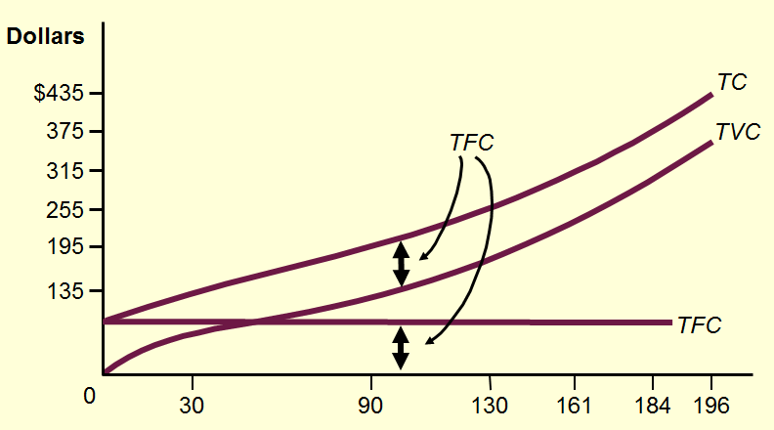
Total cost curves

Slide 10
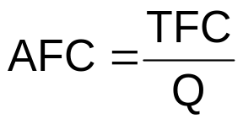
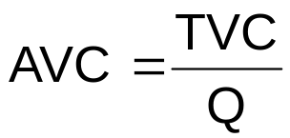
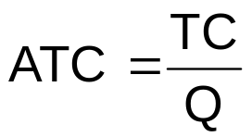
Average Costs
Average fixed cost (AFC)
  Total fixed cost divided by the quantity of output produced
Average variable cost (TVC)
  Total variable cost divided by the quantity of output produced
Average total cost (TC)
  Total cost divided by the quantity of output produced

Slide 11
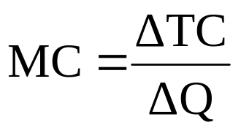
Marginal Cost
Marginal Cost
  Increase in total cost from producing one more unit or output
Marginal cost is the change in total cost (ΔTC) divided by the change in output (ΔQ)
  Tells us how much cost rises per unit increase in output
  Marginal cost for any change in output is equal to shape of total cost curve along that interval of output

Slide 12
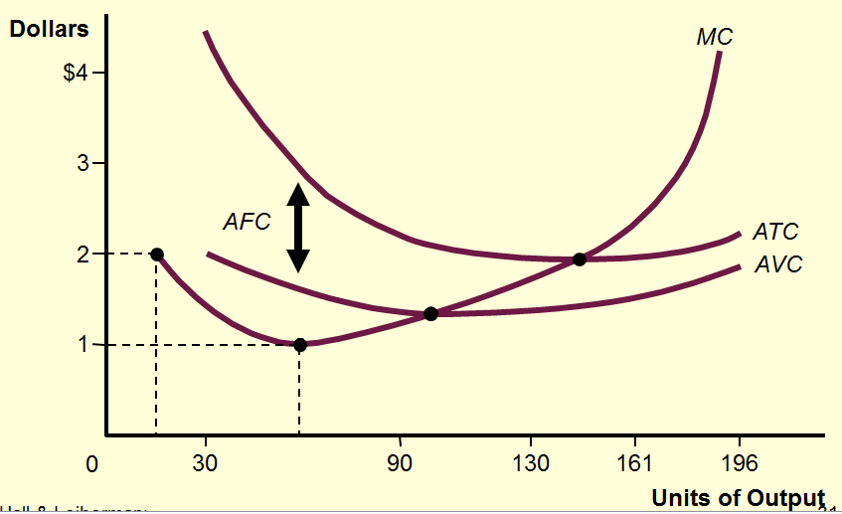
Average and Marginal costs

